Slide 1
Modeling Thermal Energy Storage
Karl Heine
Colorado School of Mines

Slide 2
Agenda
Motivation: Modeling Challenges
Improving the Models
Identifying Potential Benefits
Example Results
Distributed Ice Storage Systems

Slide 3
Modeling Challenges
Models are Tedious to Build
TES is ignored as a design option
Implementing Control Strategies Not Obvious
“Optimal” operating points unidentifiable
Imposing power limits on hardware not easy
Limited Performance Data Available
Generic curves used

Slide 4
Improving Models
Goal: Make ASHRAE Design Guide for Cool Thermal Storage recommendations available to energy modelers using EnergyPlus
Design Configuration Options
Storage Objective Options
High-level Operating Strategy Options
Provide Load Limiting Options on Chiller
Method: OpenStudio Measure Scripting

Slide 5
Potential Benefits of Ice Thermal Storage
Chiller Downsizing
Reduced Capital Costs
Higher Average Part-Load Operation
Improved Average Efficiency
Reduction in Annual Electricity Use!
Effective Load-Shifting Out of On-Peak Hours
Controllable Energy Storage

Slide 6
Example Results Central Ice
School with Air-Cooled Chiller in Houston (TMY3)
DOE Prototype 90.1-2010 Model with Modifications:
Hardware:
Chiller Downsized by 30%
2000 Ton-Hours of Ice
Configuration: Chiller Upstream of Ice Tank
High Level Control Strategy:
Ice Priority up to 30% of Design Load
0800-2000 on Weekdays
Chiller Limit: 65% of Nominal Capacity During Ice Discharge

Slide 7
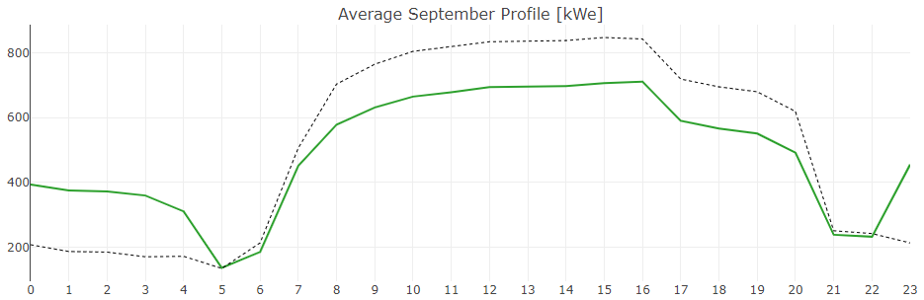
Average Daily Profile for Facility Electric Load
Baseline With Ice Storage
kWe

Slide 8
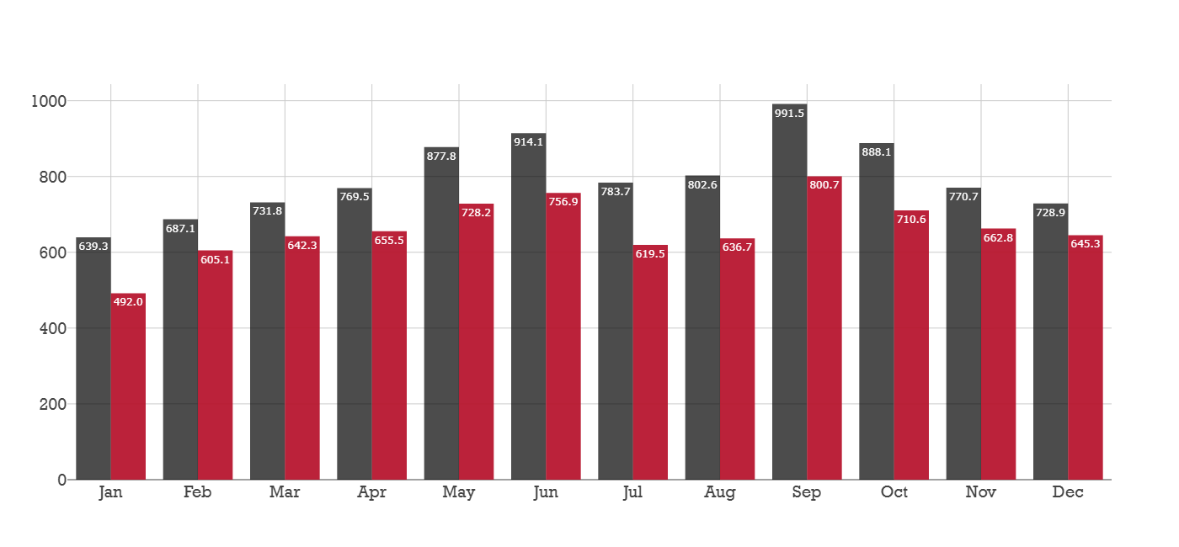
Maximum Monthly Facility Electric Demand
Baseline With Ice Storage
kWe

Slide 9
Results Summary
Model | EUI [kWh/m²] | Chiller Annual Electricity [MWh] | Chiller Average COP | Chiller Runtime Hours
School Baseline | 157.7 | 973 | 2.55 | 5947
School With Ice* | 150.5 (-4%) | 845 (-23%) | 3.07 (+20%) | 5768 (-3%)
* Includes downsized chiller yet produced no change in unmet-hours from baseline model.

Slide 10
Distributed Ice Storage
Unitary Thermal Storage Systems (UTSS) provide smaller-scale, distributed ice storage solutions
40 ton-hour ice batteries
Up to 15 tons cooling from ice unit
Compatible with 3-20 ton commercial AC units
4-6 hours of shifted cooling load
Adds cooling coil to air stream

Slide 11
Example Results Distributed Ice
Stand-Alone Retail with 4 RTU’s
DOE Prototype Models in 15 Climate Zones (TMY3)
Ice Batteries Added to Each RTU
Sized to Meet Climate Zone-Specific Loads
Utility Rates with 5-6 Hour Daily On-Peak Price Periods

Slide 12
Economic Impact of Distributed Ice Storage

Slide 13
Electricity Bill Savings with Distributed Ice

Slide 14
Summary
Modeling Challenges
Improving the Models
Identifying Potential Benefits
Example Results
Distributed Ice Storage Systems

Slide 15
Questions?
Karl Heine
kheine@mines.edu

